Slide 1
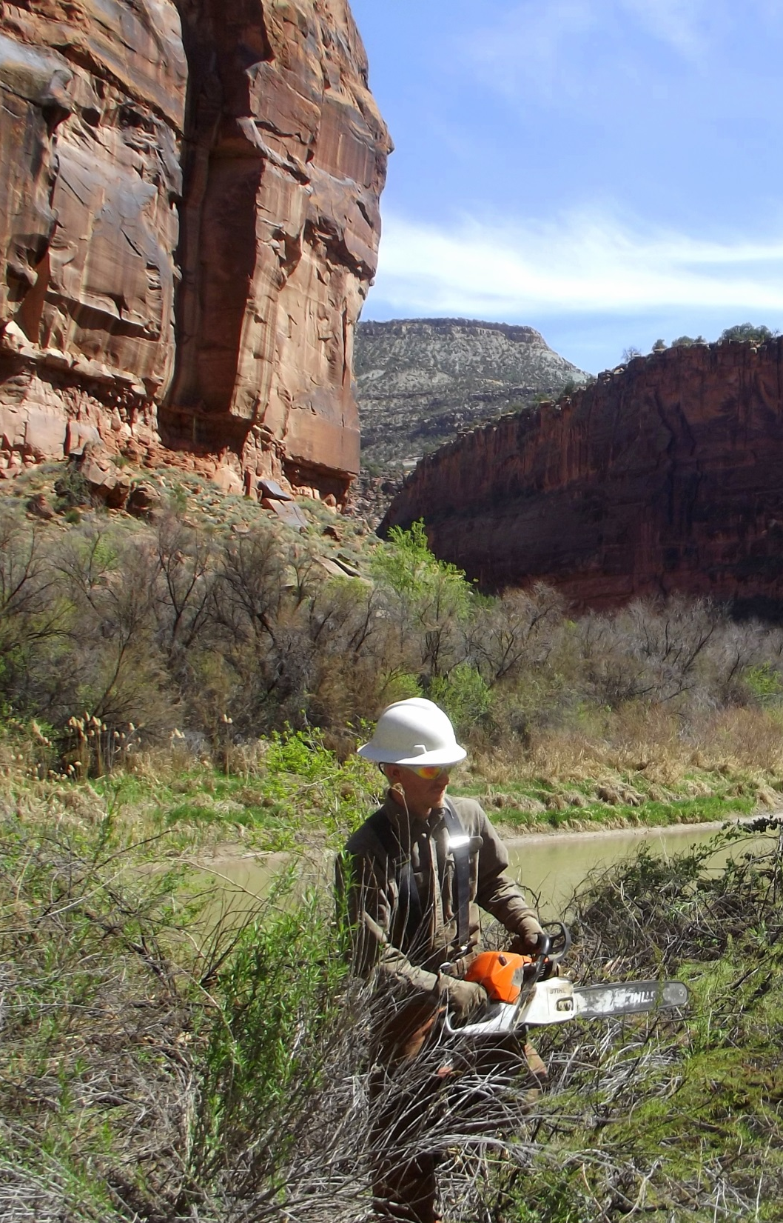
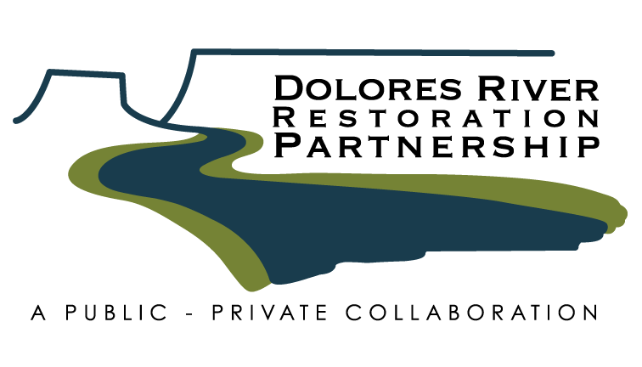
2016 Project Implementation, Maintenance, & Monitoring
Daniel Oppenheimer
Tamarisk Coalition

Slide 2
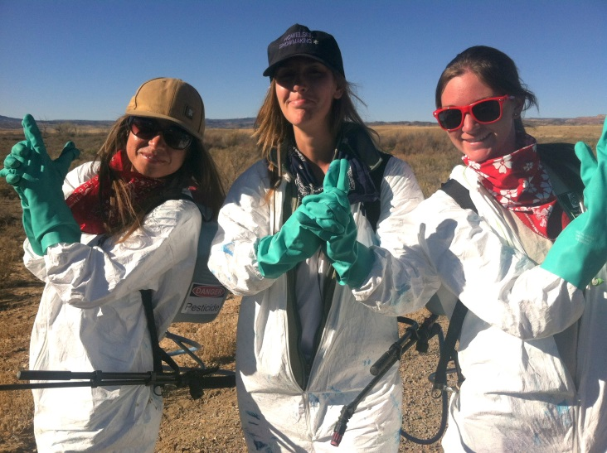
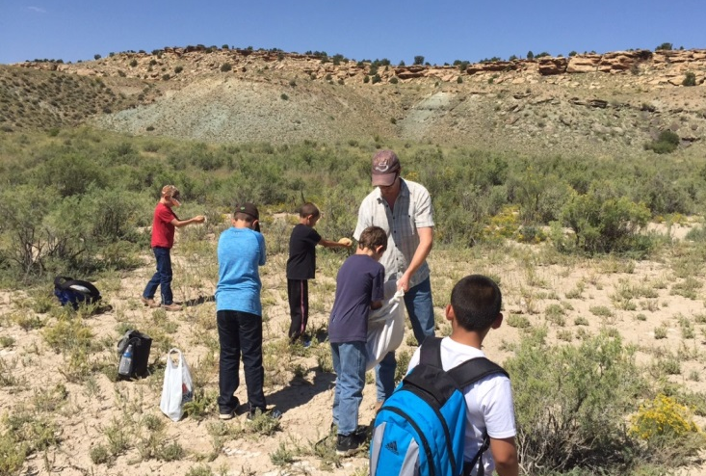
Tres Rios BLM:
Strike team conducting Russian knapweed treatments
Strike team conducting tamarisk re-sprouts treatments
Dove Creek School Planting Project

Slide 3
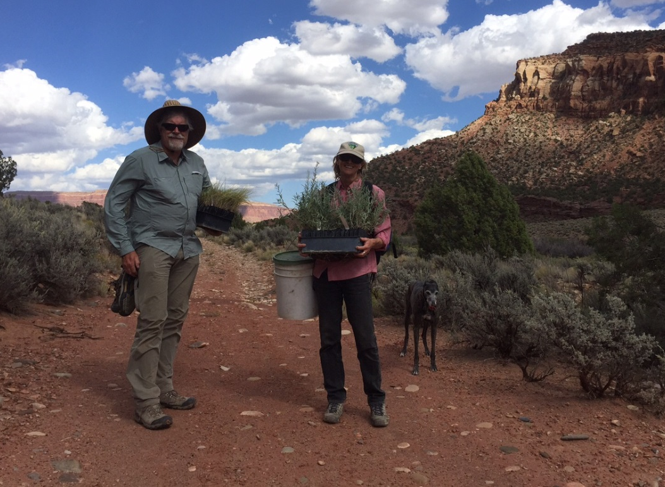
Uncompahgre BLM:
County, contractors, and strike teams conducting herbaceous weed treatments
Integrate the knapweed gal midge
Volunteers removing tamarisk and planting native shrubs and trees

Slide 4
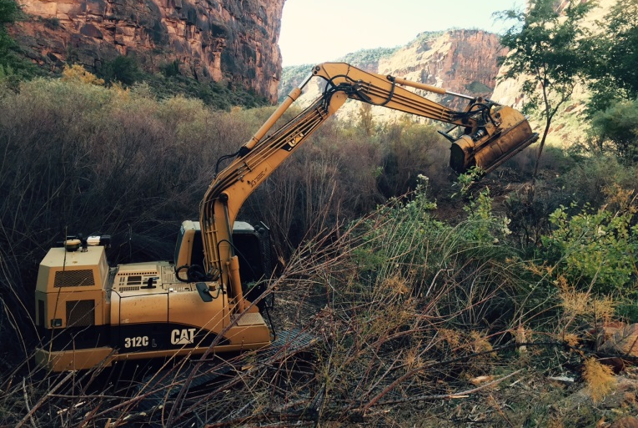
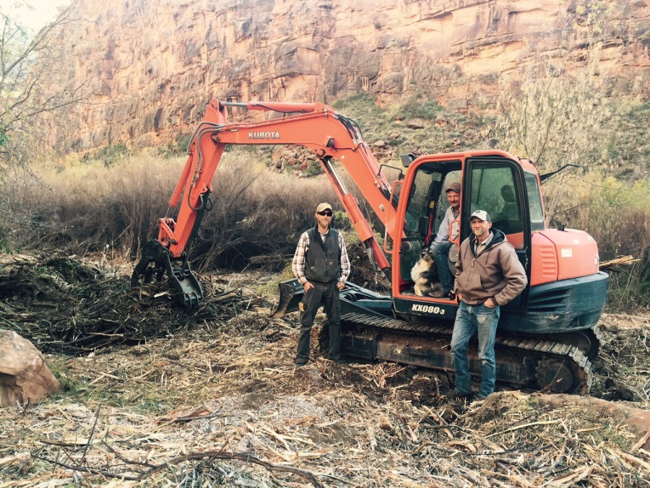
Grand Junction BLM:
Contractors and Conservation Corps crews removing tamarisk
County, contractors, and strike teams conducting herbaceous weed treatments

Slide 5
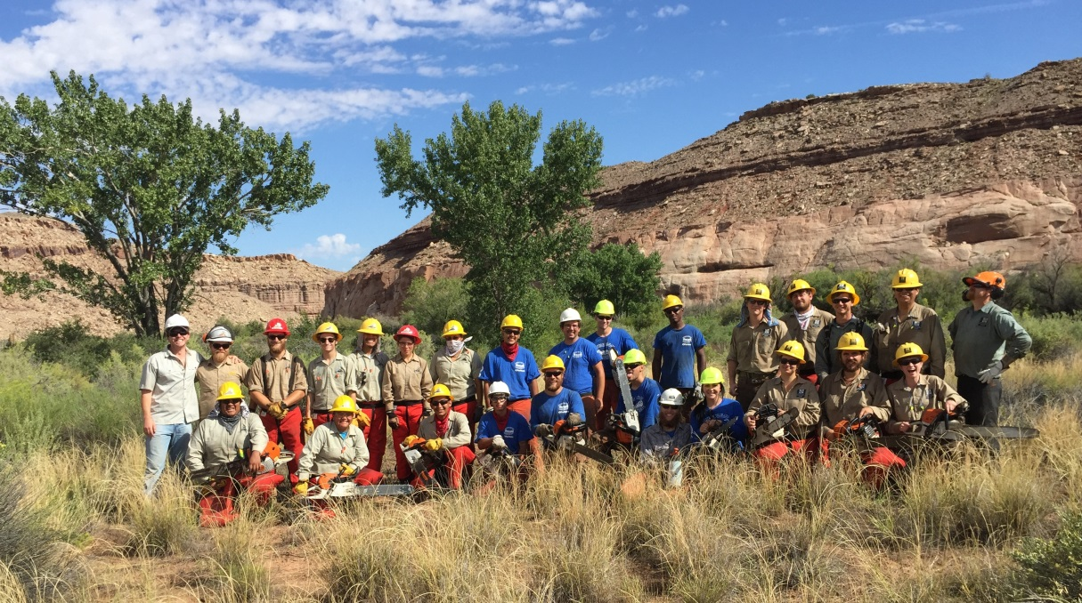
Moab BLM:
County and strike teams conducting herbaceous weed treatments
Conservation Corps crews removing tamarisk
BLM drill seeding, assessing potential berm removal

Slide 6
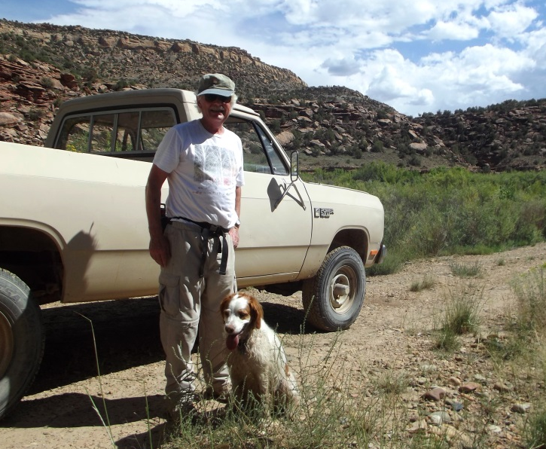
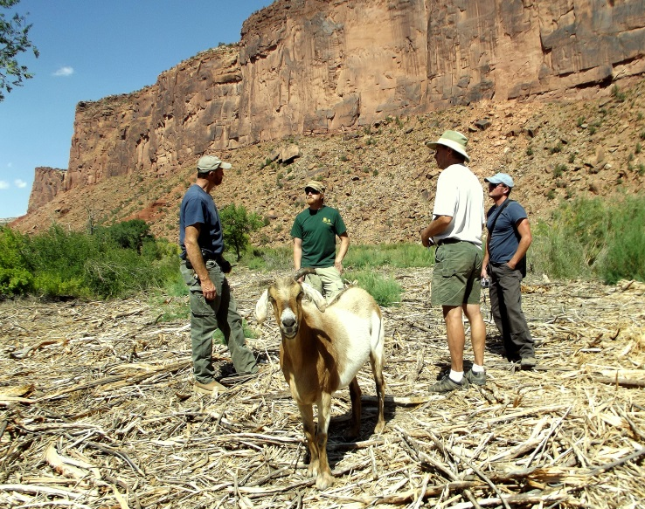
Private Lands:
US FWS Partners Program, NRCS, US Dept. of Energy, Conservation Corps Crews, counties, and University of Utah Rio Mesa Center working with private landowners

Slide 7
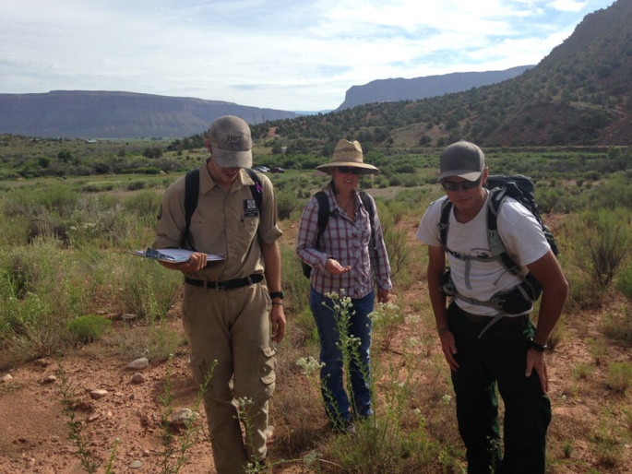
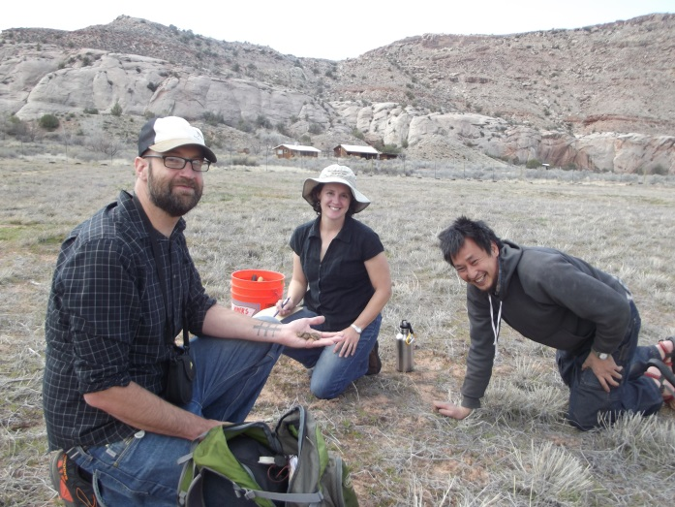
Monitoring:
Watershed-Wide Monitoring
Rapid Monitoring
Pilot Project Monitoring
Bird Monitoring

Slide 8
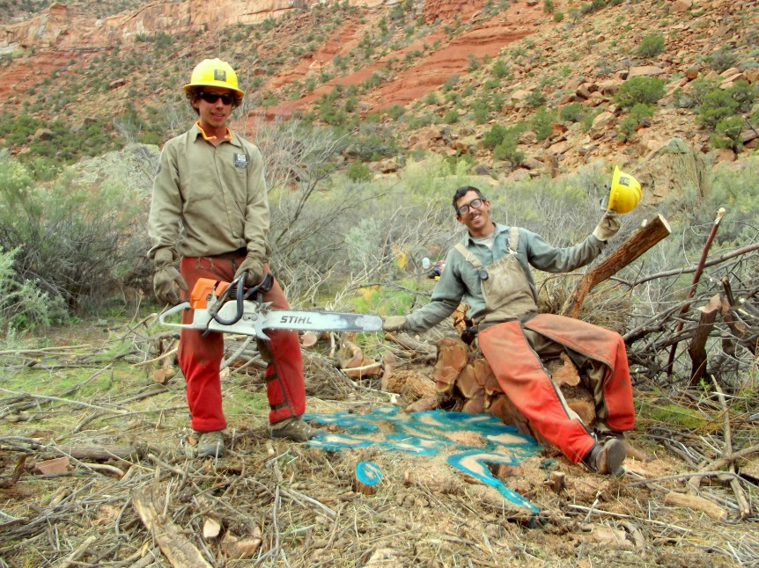
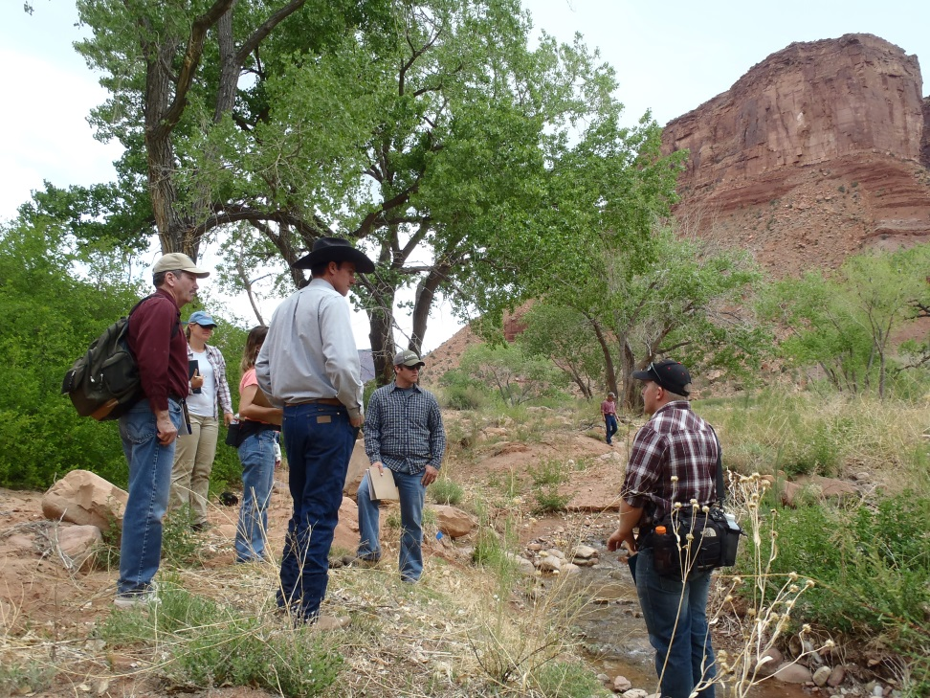
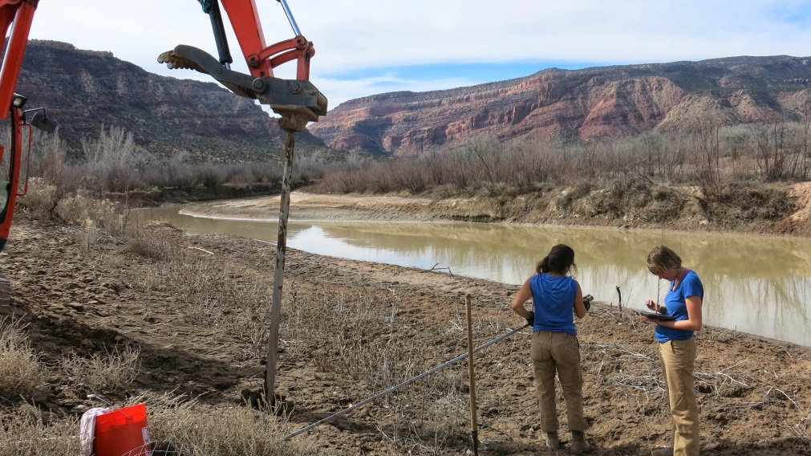
To learn more, visit us at: http://ocs.fortlewis.edu/drrp/
Or contact me: 970-256-7400
doppenheimer@tamariskcoalition.org

